Slide 1
Lecture 2 Digital Differential Analyser Line Drawing Algorithm
Step 1: Enter the coordinates of a line x1, x2, y1, y2
Step 2: Calculate slope of line as per m=(y2-y1)/(x2-x1)
Step 3: Check if slope m is <=1 or > 1
Step 4: if m <=1 then,
Xnew=X1+1
Ynew=Y1+m(rounded off)
Iteration goes on till (x2-x1) times
Step 5: if m > 1 then,
Xnew=X1+1/m (rounded off)
Ynew=Y1+1
Iteration goes on till (y2-y1) times

Slide 2
Advantages of DDA line drawing Algorithm
Faster method of calculating pixel positions than direct use of line equation y=mx+b
Disadvantages of DDA line drawing Algorithm
The accumulation of round off error in successive additions of the floating point increment cause the calculated pixel positions to drift away from true line.
Rounding operations and floating point arithmetic calculations are still time consuming

Slide 3
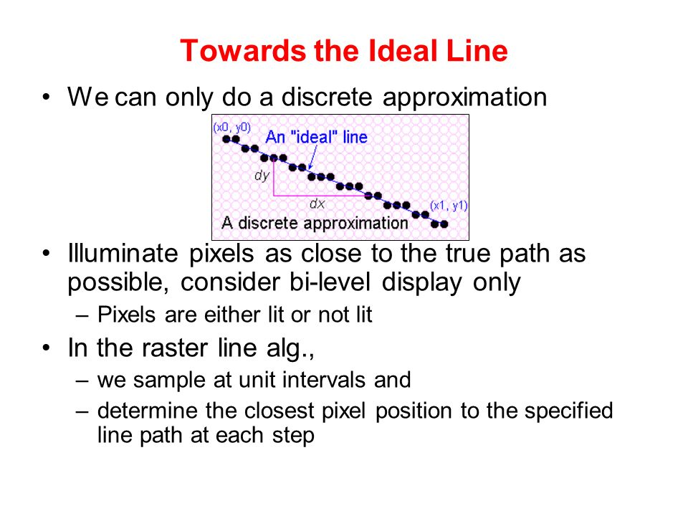

Slide 4
Case of Floor function/Ceiling Function during Coding
Let say y coordinate entered is 2.2, the calculated slope is 0.6 so the coordinate of plotted y pixel is 2.2+0.6 = 2.8 which has to be rounded off to 3 to plot the pixel on screen. But by default it becomes 2 after fraction part is eliminated.
To do effective round off add 0.5 extra to the y coordinate so 2.2+0.5 +0.6(m) =3.3, now after fraction part elimination plotted y pixel becomes 3.

Slide 5
Bresenham’s Line Drawing Algorithm for m<1
Step 1: Input the two line endpoints and store the left endpoints in (x1, y1)
Step 2: Plot the first point
Step 3: Calculate dx and dy i.e (x2-x1) and (y2-y1) and obtain the starting value of the decision parameter
p=2dy-dx
Step 4: if p<0, next plotted point is (x(last)+1,y(last)) and
new p=last p+2dy
else (p>0) next plotted point is (x(last)+1,y(last)+1) and
new p=last p+2dy-2dx
Step 5: Repeat the whole procedure dx times

Slide 6
